Slide 1

Skin Cancer Classification

Slide 2
Overview
Introduction
Dataset and EDA
Data preprocessing
ML Models
Web App
Conclusions

Slide 3
Introduction
Skin Cancer
Image Classification
Prevalence
Skin cancer is one of the most common types of cancer globally.
Early Detection
Early detection is crucial for successful treatment and improved outcomes.
Visual Diagnosis:
Dermatologists often rely on visual inspection for diagnosis, making it a suitable candidate for image classification.
Overview
Image classification is a machine learning technique that assigns predefined labels or categories to images.
How
Using deep Neural Networks, can classify skin lesions faster and potentially more accurately than healthcare professionals.
Why
This would save time and reduce strain on resources.

Slide 4
Introduction
Skin Cancer
Image Classification
Prevalence
Skin cancer is one of the most common types of cancer globally.
Early Detection
Early detection is crucial for successful treatment and improved outcomes.
Visual Diagnosis:
Dermatologists often rely on visual inspection for diagnosis, making it a suitable candidate for image classification.
Overview
Image classification is a machine learning technique that assigns predefined labels or categories to images.
How
Using deep Neural Networks, can classify skin lesions faster and potentially more accurately than healthcare professionals.
Why
This would save time and reduce strain on resources.

Slide 5
Dataset - Skin Cancer MNIST: HAM10000
HAM10000 ("Human Against Machine with 10000 training images") dataset. Available from: https://www.kaggle.com/datasets/kmader/skin-cancer-mnist-ham10000
Contains labelled images of the 7 most important diagnostic categories of skin lesions:
Actinic keratoses
Basal cell carcinoma
Benign keratosis-like lesions
Dermatofibroma
Melanoma
Melanocytic nevi
Vascular lesions
Also contains the patients age, sex and the localization of the lesion.

Slide 6
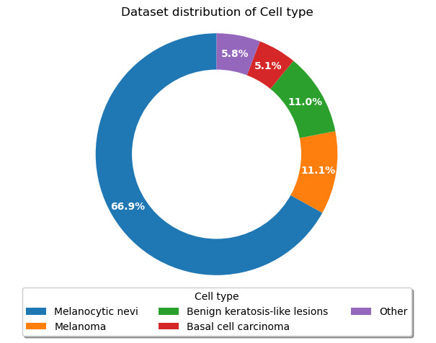
EDA – Lesion type

Slide 7
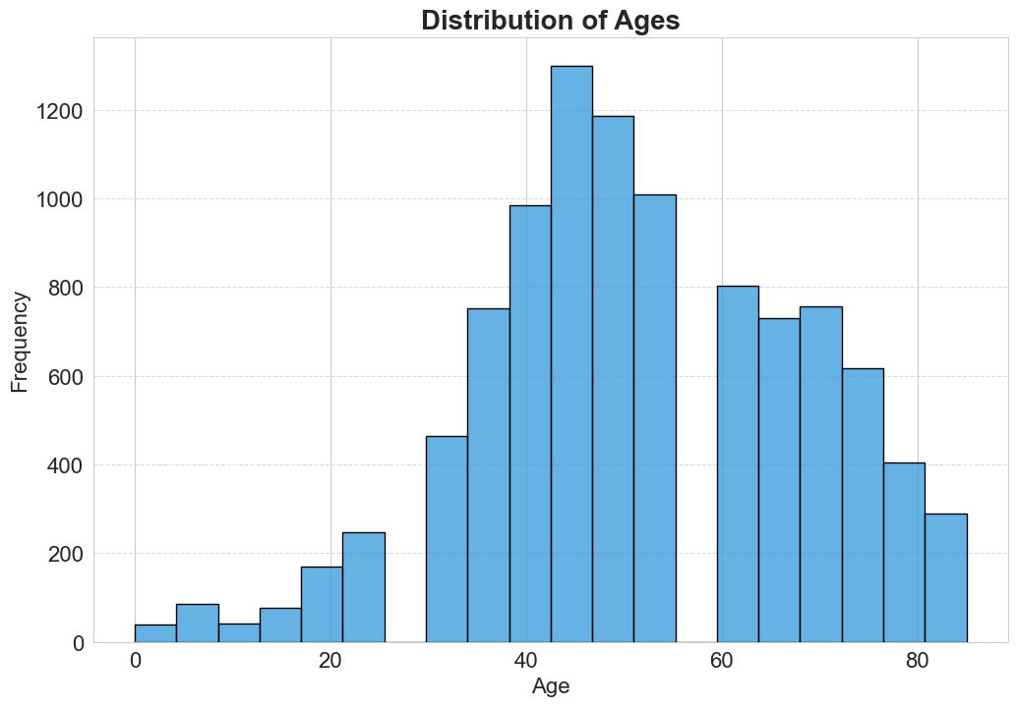
EDA – Age

Slide 8
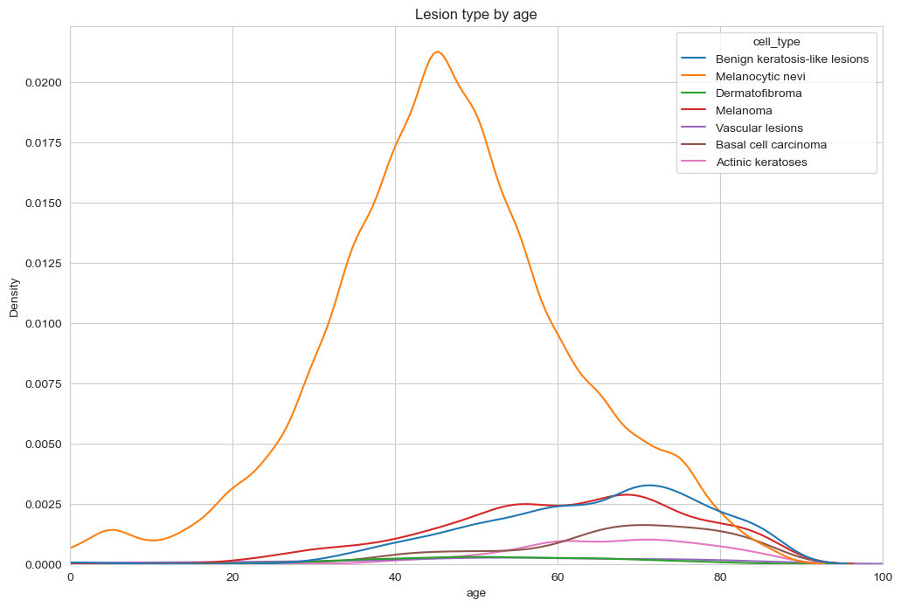
EDA – Age and lesion type

Slide 9
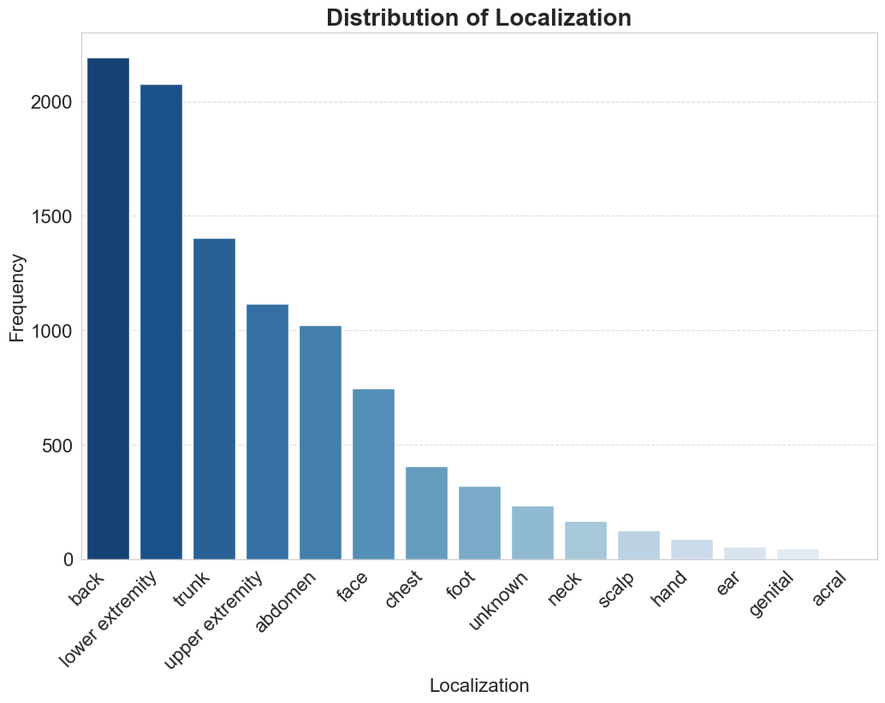
EDA – Localization

Slide 10
Data Preprocessing
Dataset was very clean, only had NaN values in Age column (0.5%). Filled these with the mean.
Resized images to be more manageable (100x75 pixels)
Train/Validation/Test split
Data Augmentation

Slide 11
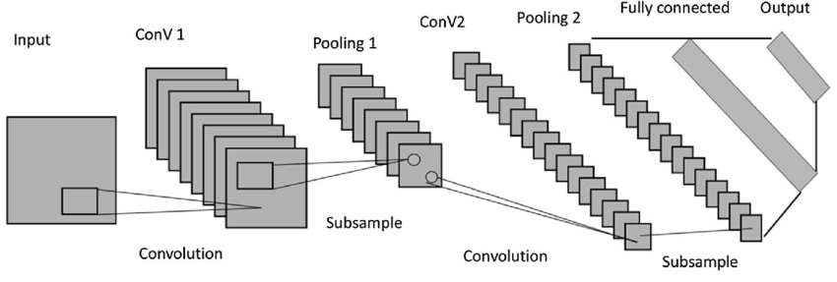
ML Models - Overview
Convolutional Neural Networks (CNNs) are a class of deep learning models specifically designed for processing and analyzing visual data.

Slide 12
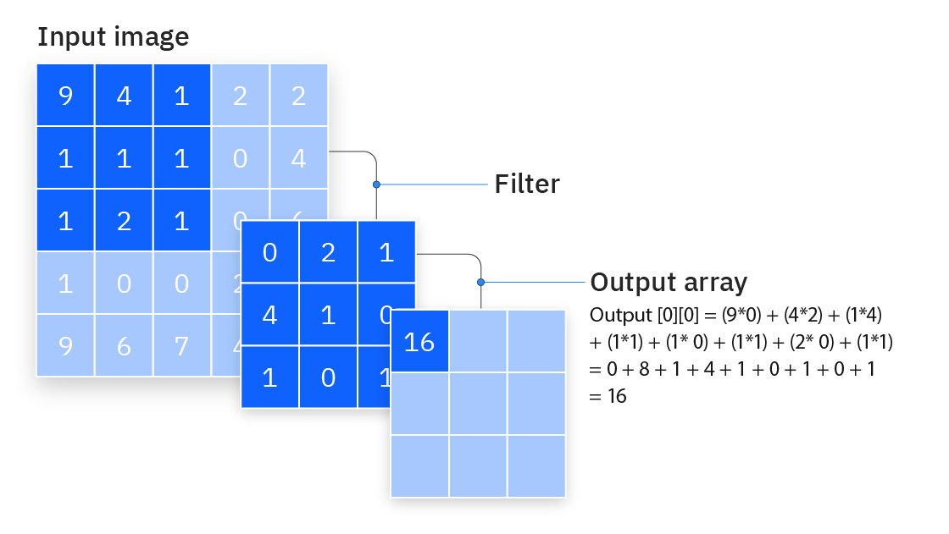
ML Models – Convolutional Layers

Slide 13
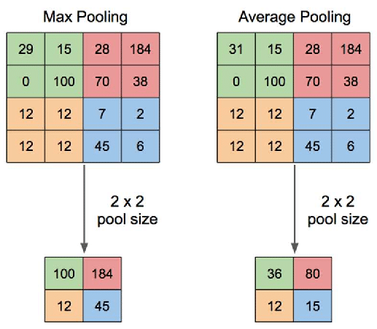
ML Models – Pooling Layers

Slide 14

ML Models – Dropout Layers

Slide 15
ML Models - Overview
Convolutional Neural Networks (CNNs) are a class of deep learning models specifically designed for processing and analyzing visual data.

Slide 16
Model Performance

Slide 17
Model Summary
Architecture | Input | Output | Parameters
CNN Binary | Image | Cancerous vs Non-Cancerous | 3,752,354
CNN | Image | Lesion type | 3,752,354
VGG16 | Image | Lesion type | 14,911,815
MobileNet | Image | Lesion type | 2,266,951
Multi-input | Image, Age, Sex and Localization | Lesion type | 3,081,947

Slide 18
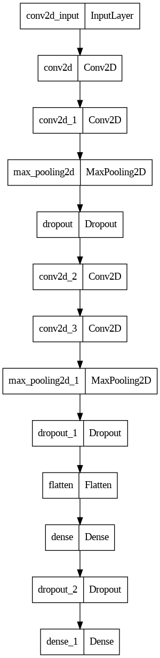
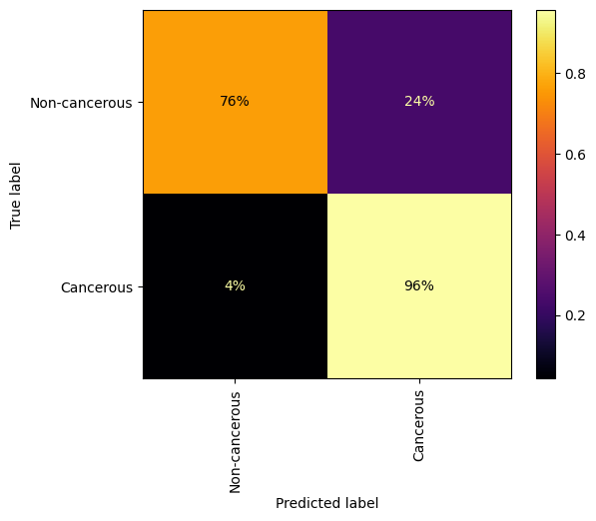
ML Models – Binary CNN

Slide 19
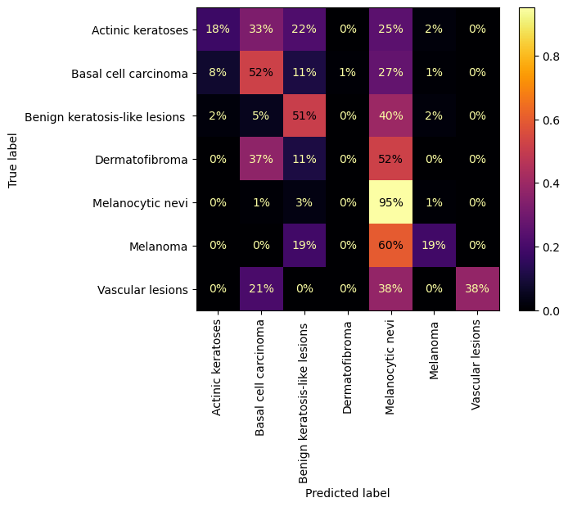
ML Models – CNN

Slide 20
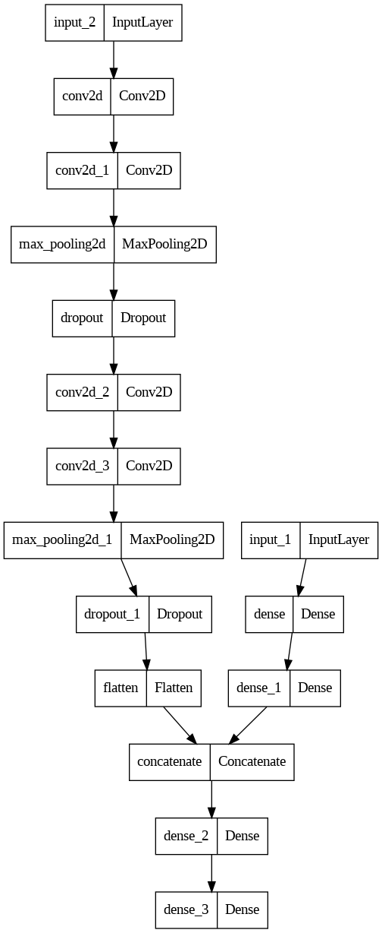
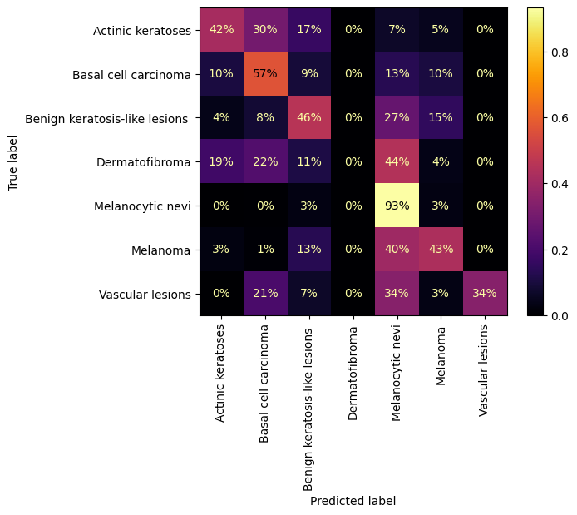
ML Models – Multi-Input

Slide 21
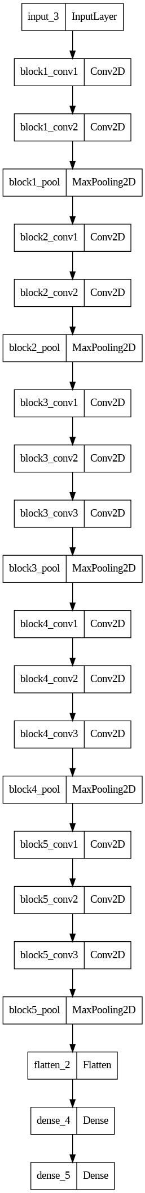
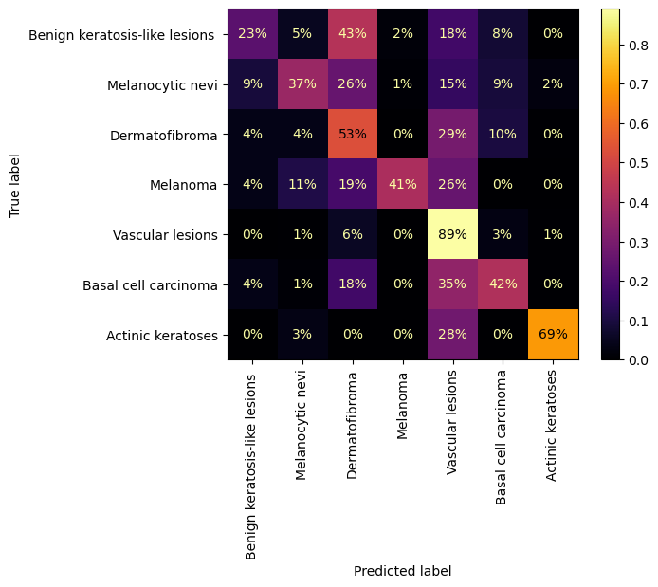
ML Models – VGG16

Slide 22
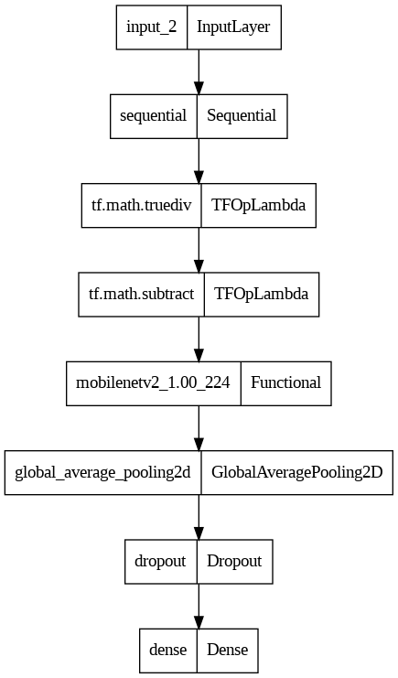
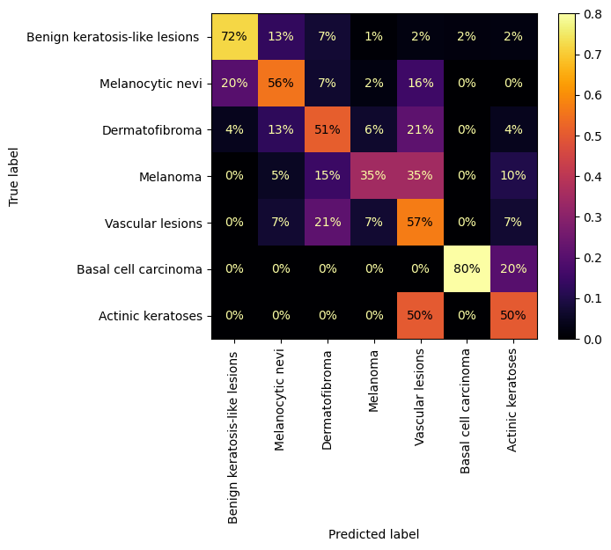
ML Models – MobileNet*

Slide 23
What are the models looking for?
To better understand what the model is looking for I have used the gradient-weighted class activation mapping (Grad-CAM) technique.
Grad-CAM is a visualization technique used to interpret the decisions made by machine learning models. It highlights the regions in an input image that are important for a model's prediction.
Why is this useful?
Identifies potential issues and biases in the model's learning patterns.
Validates whether the model is focusing on relevant features.

Slide 24
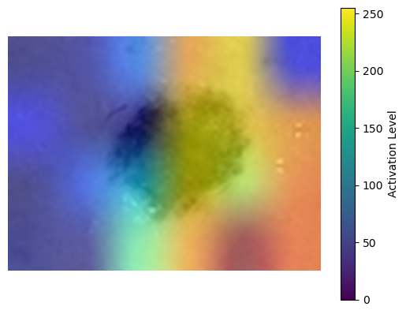
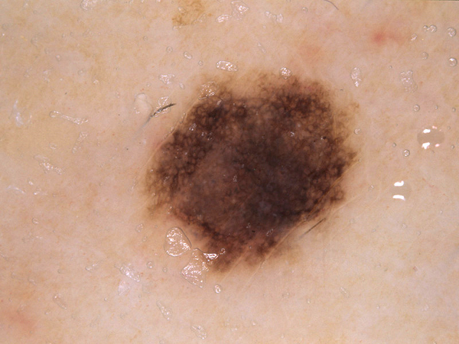
What are the models looking for?
Input Image
Model Activation (VGG)

Slide 25
Web App
Created Flask App in Python.
Allows users to see EDA and model comparison.
Select a model and upload an image to have it classified.

Slide 26
Web App
Demonstration

Slide 27
Future Work
Apply resampling or weighting to all models to combat imbalance.
Fine tune al models to improve performance.
Improve report generation in the Flask app.
Launch Flask app to be available for use.

Slide 28
Conclusions
Used HAM 10000 Skin Lesion dataset.
Explored dataset, discovering an imbalance.
Compared several ML models performance on the dataset.
Produced flask app for easy use of models for lesion classification.

Slide 29

Any questions?

